Slide 1

Federal Reserve Symposium Cal State LA
Francisco Buenrostro | Guillermo Hernandez | Leon Lau

Slide 2
Table of Contents
Contents
Current State of The Economy 3 - 11
Estimating Equations and Forecasts 12 - 17
Overall Assessment of Future Conditions 18
Monetary Policy Recommendation 19

Slide 3
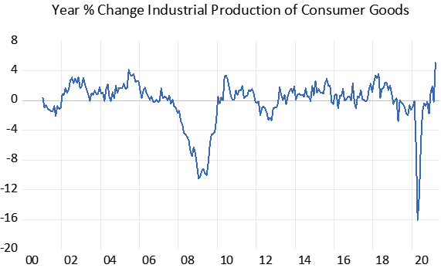
Current State of The Economy
Industrial Production of Consumer Goods: index of industrial production and the related capacity indexes and capacity utilization rates cover manufacturing, mining, and electric and gas utilities.
The year % change of the industrial production index for March 2021 saw an increase of 5.1%

Slide 4
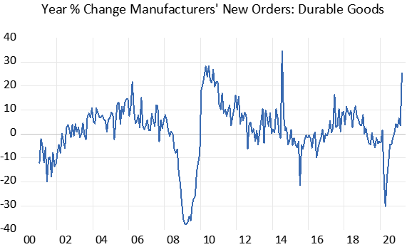
Current State of The Economy
Manufacturers’ New Orders: Durable Goods: value of new orders placed with manufacturers for immediate or future delivery of durable goods.
The year % change of manufacturers new orders: durable goods for March 2021 saw an increase of 25.3%

Slide 5
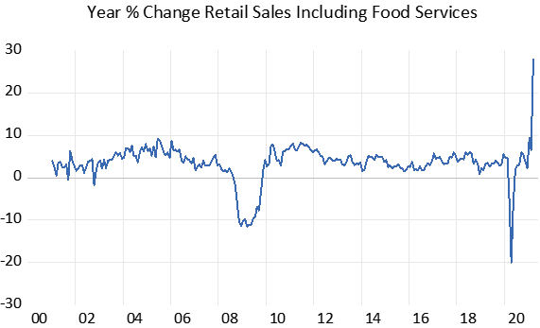
Current State of The Economy
Retail Sales Including Food Services: measures the total receipts of retail stores and food services establishments in the United States.
The year % change of the retail sales including food services for March 2021 saw an increase of 27.9%

Slide 6
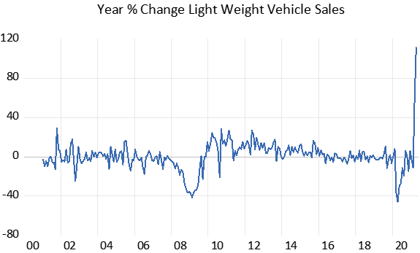
Current State of The Economy
Light Weight Vehicle Sales: measure of the total sales of light weight vehicles in the United States. This includes most consumer vehicles such as cars, SUVs, and light trucks.
The year % change of light weight vehicle sales for March 2021 saw an increase of 111.4%
Q: Why?

Slide 7
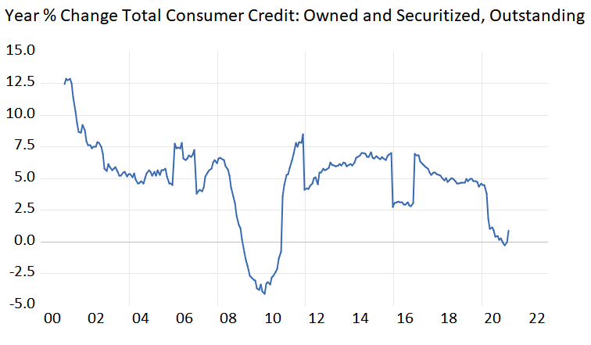
Current State of The Economy
Total Consumer Credit: Owned and Securitized, Outstanding: total amount of credit extended to individuals for personal, family, or household purposes.
The year % change of the total consumer credit: owned and securitized, outstanding for March 2021 saw an increase of 1%

Slide 8
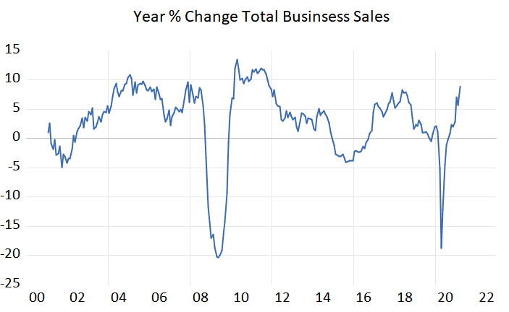
Current State of The Economy
Total Business Sales: tracks the total value of sales made by businesses in the United States. This includes sales from manufacturers, retailers, and wholesalers.
The year % change of total business sales for February 2021 saw an increase of 5.7%

Slide 9
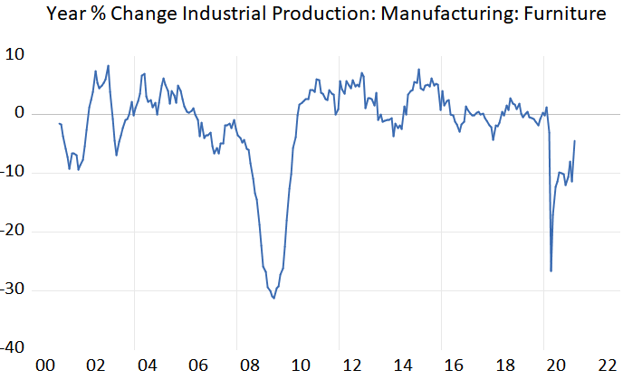
Current State of The Economy
Industrial Production: Manufacturing: Furniture: measures the total output of the furniture manufacturing industry in the United States. It is part of the broader Industrial Production Index that tracks production levels across various manufacturing sectors.
The year % change of the industrial production: manufacturing: furniture for March 2021 saw an increase of 4.5%

Slide 10
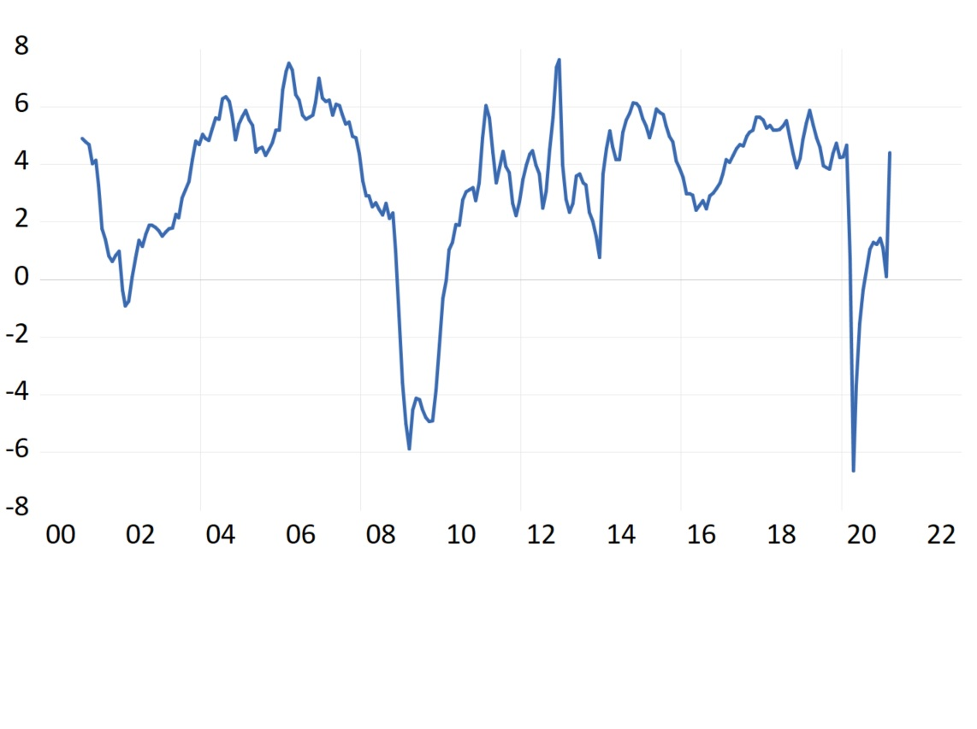
Current State of The Economy
Compensation: the total earnings of employees, which include wages, salaries, and additional benefits. The compensation data provides a comprehensive view of how much employees are paid in various industries and sectors.
Year % Change in Compensation
The year % change of compensation for March 2021 saw an increase of 4.4%

Slide 11
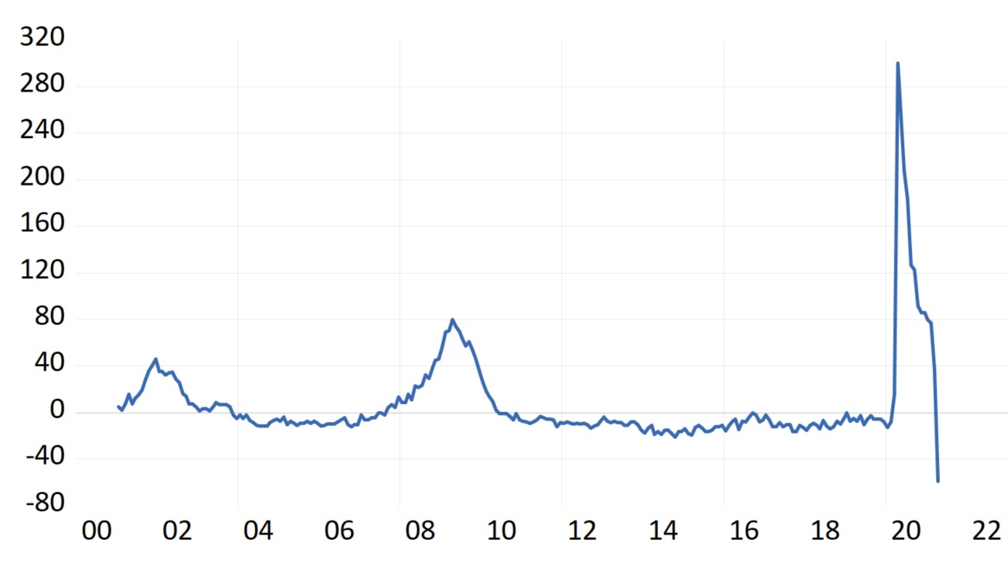
Current State of The Economy
Unemployment: measures the percentage of the labor force that is actively seeking work but is unable to find employment.
Year % Change in Unemployment
The year % change of unemployment for April 2021 saw a decrease of 58.8%

Slide 12
Estimating Equation and Forecast
Equation
Gross Domestic Product = f( IP, EPR, CT, GDP(-1), Trend)
GDP – Gross Domestic Product:
IP – Industrial Production Consumer Goods:
EPR – Employment-Population Ratio:
CT – Federal government current tax receipts: taxes on corporate income
GDP(-1) – Gross Domestic Product: lagged one period
Trend – The overall direction of the market

Slide 13
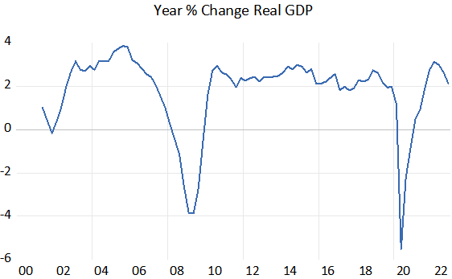
Estimating Equation and Forecast
Forecast
Gross Domestic Product = f( IP, EPR, CT, GDP(-1), Trend)
GDP Forecasted Values
2021 4.64%
2022 2.73%

Slide 14
Estimating Equation and Forecast
Equation
Consumer Price Index = f( ASPNHSUS, CPIUCEDCA, EIUIQ, EIUIR, EMPHE, INDPRO, IPDGMSPCBO, IPEBE, IPMAT, IPMDGCE, IPMDGF, IPMDGMED, TOTALSL, TOTBUSSMSA)
CPI - Consumer Price Index
ASPNHSUS - Average Sales Price of Houses Sold for the United States, Dollars, Quarterly, Not Seasonally Adjusted
CPIUCEDCA - Consumer Price Index for All Urban Consumers: Education in U.S. City Average
EIUIQ - Monthly Export Price Index
EIUIR - Monthly import price index
EMPHE - Employment, Hours, and Earnings from the Current Employment
INDPRO - Industry Production: total
IPMAT - Industrial Production: Materials
IPDGMSPCBO - Industrial Production: Durable Goods Materials: Semiconductors, Printed Circuit Boards, and Other
IPEBE - Industrial Production: Equipment: Business Equipment
IPMDGCE - Industrial Production: Manufacturing: Durable Goods: Computer and Electronic Product
IPMDGF - Industrial Production: Manufacturing: Durable Goods: Furniture and Related Product
IPMDGMED - Industrial Production: Manufacturing: Durable Goods: Medical Equipment and Supplies
TOTALSL - Total Consumer Credit Owned and Securitized, Outstanding, Billions of Dollars
TOTBUSSMSA - Total Business Sales, Millions of Dollars

Slide 15
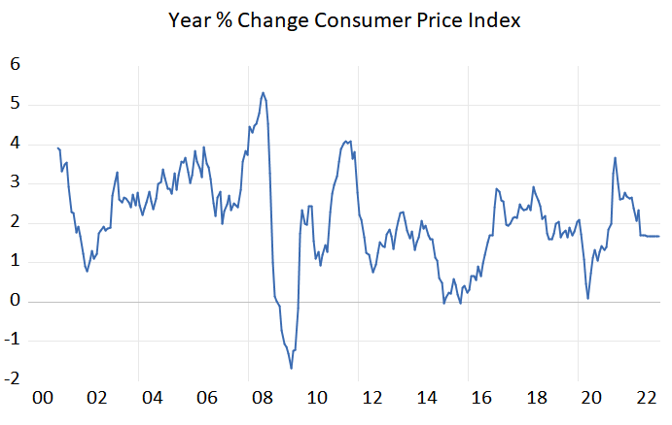
Estimating Equation and Forecast
Forecast
Consumer Price Index = f( ASPNHSUS, CPIUCEDCA, EIUIQ, EIUIR, EMPHE, INDPRO, IPDGMSPCBO, IPEBE, IPMAT, IPMDGCE, IPMDGF, IPMDGMED, TOTALSL, TOTBUSSMSA)
CPI Forecasted Values
2021 2.43%
2022 1.65%

Slide 16
Estimating Equation and Forecast
Equation
Unemployment Rate = f( Compensation, Unemployment(-1), Trend)
Compensation - Compensation of Employees, Received: Wage and Salary Disbursements
Unemployment - Unemployment Rate
Unemployment(-1) - Unemployment Rate Lagged One Period
Trend - The Overall Direction of The Market

Slide 17
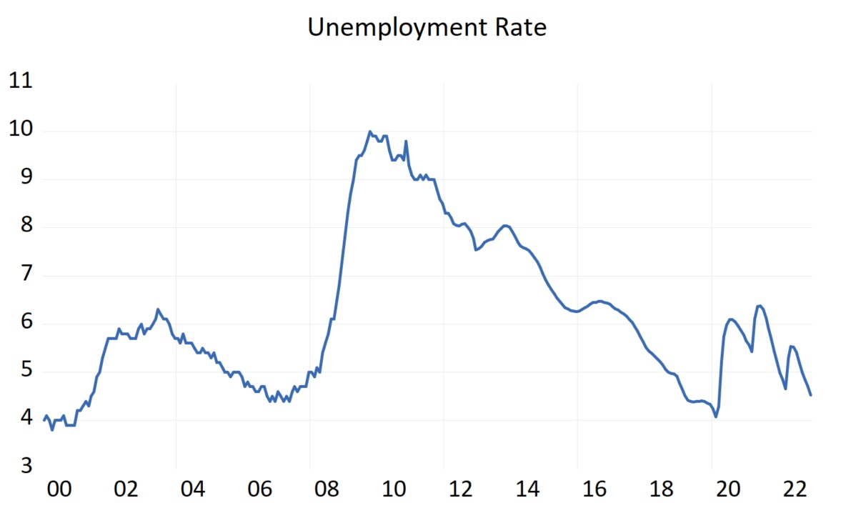
Estimating Equation and Forecast
Forecast
Unemployment Rate = f( Compensation, Unemployment(-1), Trend)
Unemployment Forecasted Values
2021 5.21%
2022 4.52%

Slide 18
Overall Assessment of Future Conditions
Economic indicators for consumption and investment show strong growth in the economy
GDP
Inflation
Unemployment
Forecasted Change
2021 4.64%
2022 2.73%
Forecasted Change
2021 2.43%
2022 1.65%
Forecasted Change
2021 5.21%
2022 4.52%
GDP is expected to grow 4.6% in 2021, then slow to 2.7% in 2022. US inflation is expected to climb to 2.4% in 2021, then fall to 1.7% in 2022. The unemployment rate is expected to increase to 5.2% in 2021, then decrease to 4.5% in 2022

Slide 19
Monetary Policy Recommendation
Recommendation
Policy Recommendation
Monitoring Recommendations
At this time, the Federal Reserve should not make any changes to its current monetary policy.
Continue to monitor the Consumer Price Index
If inflation continues to increase, then consider implementing a contractionary monetary policy

